Slide 1
Data Cleaning with python & Pandas
Esther Perez, Digital Scholarship Librarian

Slide 2
Agenda
Introduction
Best practices
Steps toward clean data
Available tools
Practice cleaning with Python
Final tips & takeaways

Slide 3
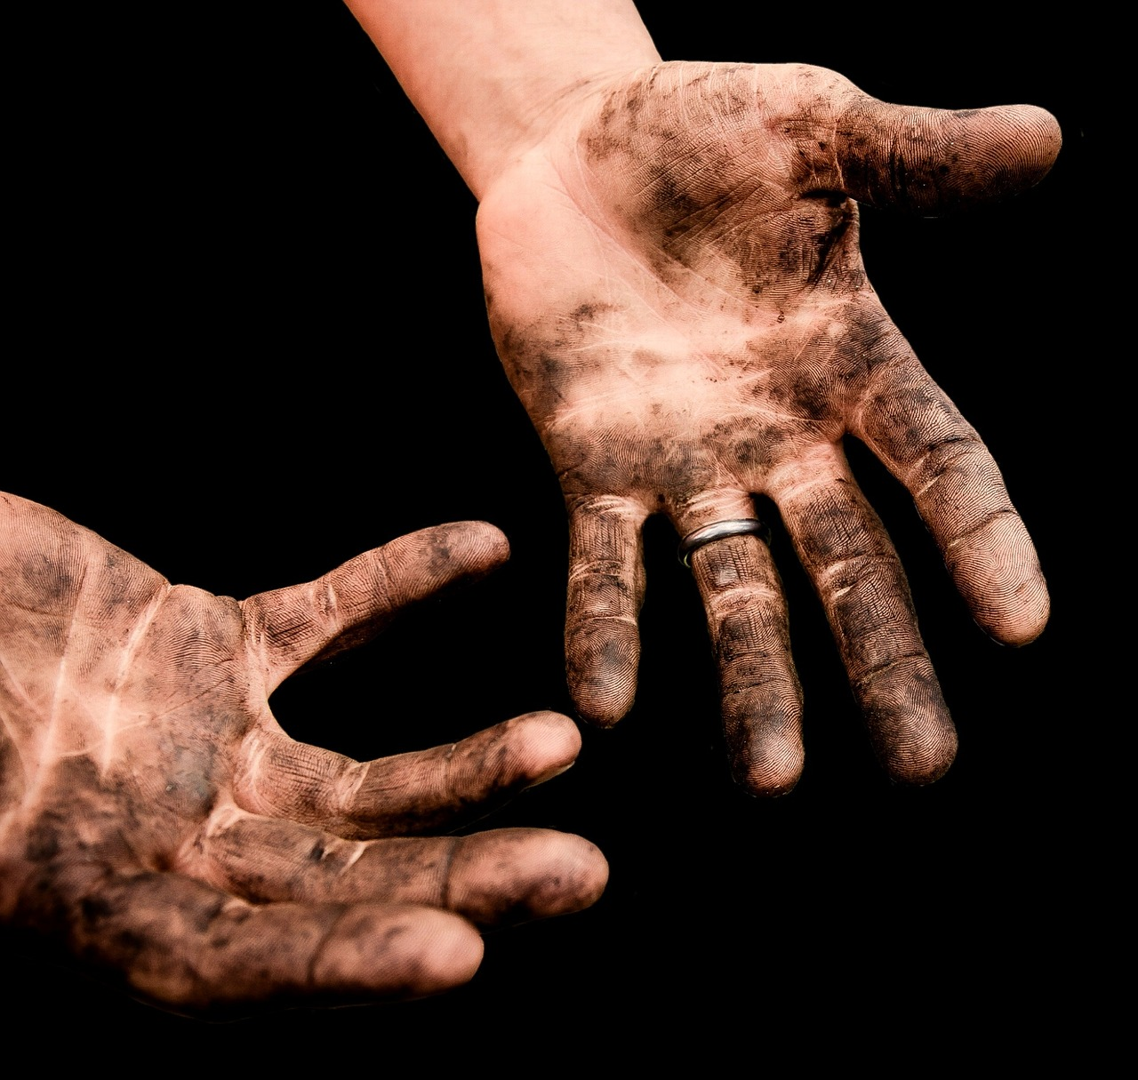
Why do I need to clean my data? Is it dirty?🤨
Yes, probably!
Image by Alexa (Alexas_Fotos) from Pixabay

Slide 4
Tidy data is clean data
Every column is a single variable
Variable1 | Variable2 | Variable3
value1,1 | value1,2 | value1,3
value2,1 | value2,2 | value2,3
value3,1 | value3,2 | value3,3
Column headers
Every row is a ‘measurement’
Every cell is a single value

Slide 5
Data best practices
Create a copy of your data (keep a copy of raw data)
Create a readme file (data description, log changes, list abbreviations used)
Use some form of file versioning to keep track of subsequent files (e.g. by adding the date in YYYY-MM-DD format to filenames)

Slide 6

Steps to clean data​

Slide 7
STEP 1: Get to Know your data set
Issues your datasets may come with:​
  Unnecessary whitespace in cells
  Multiple data values within cells
  Multiple notation forms (i.e. not standardized)
  Missing values
  Duplicate data
  Unnecessary data

Slide 8

Step 2: Clean it​
Remove duplicate data (merge or drop)
Expand columns into single variables
Data normalization/standardization
Remove extraneous whitespace
Fill in missing values or remove those observations
Drop unnecessary data (unneeded variables for analysis)
Image by Gerd Altmann (geralt) from Pixabay

Slide 9
STEP 3: dAta validation
Identify data discrepancies​
Check for outliers
Data validation techniques
Metric​ | Measurement​ | Target​ | Actual​
Audience attendance​ | # of attendees​ | 150​ | 120​
Engagement duration​ | Minutes​ | 60​ | 75​
Q&A interaction​ | # of questions​ | 10​ | 15​0
Positive feedback​ | Percentage (%)​ | 90​ | 95​

Slide 10
Available tools for data cleaning
Though we’re focusing on using Python/Pandas in this workshop, I’ll mention a couple other options:
* R & Rstudio (+ Tidyverse packages)
* OpenRefine (web based, GUI)

Slide 11
Let’s work through a sample dataset
Download the audible_uncleaned.csv dataset for today:
  Expand columns
  Removing unnecessary data
  Standardizing data
  Fill in or remove missing values
  Remove duplicate data
  Remove extraneous whitespace
  Check for data discrepancies

Slide 12
Final tips & takeaways​
  Steps can generally be done in any order
  May need to repeat steps
  If borrowing someone else’s code, make sure you understand it yourself!​ (This includes AI generated code)

Slide 13
THANK YOU!
Esther Perez​
STEM Digital Scholarship Librarian
Coe 304D
Office no.: 307-766-5692
eperez11@uwyo.edu

