Slide 1
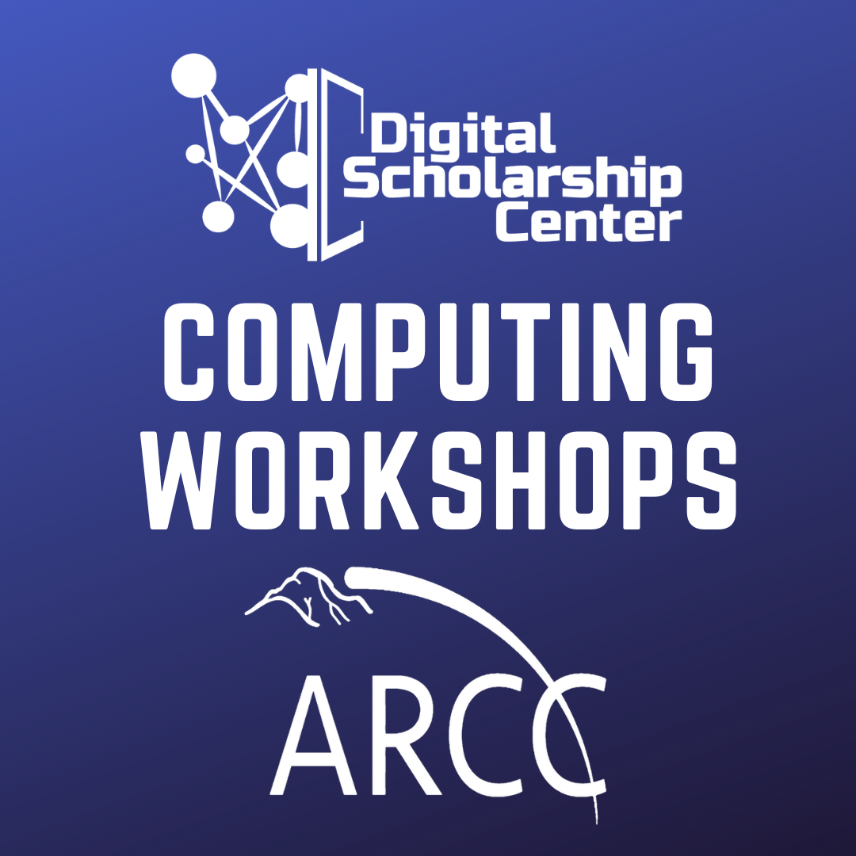

Intermediate Python
Esther Perez
UW Libraries Digital Scholarship Center
June 4, 2025

Slide 2
Learning Objectives
After this workshop, participants will be able to:
Utilize conditionals, loops and functions in their Python scripts
Define classes and call relevant methods
Define and modify advanced data structures in Python, including dictionaries and JSON objects
Read and write text and JSON files
Describe the components of coding best practices and how they can be applied to Python code

Slide 3
Leveling Up from Beginner to Intermediate
What do you need to start building code, applications, and programs in Python?
Apply the concepts of coding best practices
Loops to repeat code (aka iteration)
Conditionals for case-specific applications
Functions for customization and reusability
Reading and writing files
Working with advanced data structures specific to Python
Converting them to other common data formats

Slide 4
Coding Best Practices
Components of well-written and reusable code include:
Readability
Modularity
Maintainability
Extensibility
Reproducibility
Documentation

Slide 5
Readability
Refers to code that is well-formatted and easy to read
When in doubt, follow the PEP 8 Style Guide for Python
In the context of Python, readable code has the following characteristics:
Comprehensibility
Relevant and clear variable names
Someone should be able to look at your code and quickly understand what the overall function is supposed to be.
Legibility
Appropriate use of whitespace and indentation
Proper syntax

Slide 6
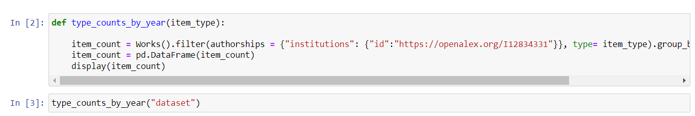
Modularity
Technique to separate long pieces of code into smaller, executable chunks
Several smaller chunks vs. one very, very long script
Allows for easier debugging and the ability to add additional functionality
Modular, generalized functions are much easier to reuse than a long, very specific script

Slide 7
Maintainability
Short-Term vs. Long-Term Maintainability
Think about who is and may be working on the code in the future
Ensure that your code contains comments and have other documentation as needed
This is also useful if you step away from a project for an extended period of time and need to remember what you were working on.
Robustness: ability for code and computer systems to handle errors and exceptions; able to work without breaking or failing
Broken code is part of the development process, but code that breaks regularly after you reach a "finished product" is not robust
Longevity: code that is able to last for substantial periods of time without requiring major updates
Code that is robust generally has longevity

Slide 8
Extensibility
Ability to add functionality or "features" to your code without significant restructuring of your code
Code that is robust is extensible
Essentially, you should be able to add functionality without breaking the existing code
Modularity facilitates extensibility
Easier to add a function to your code than rewrite your entire script for a specific use case

Slide 9
Reproducibility
Able to be reproduced outside of the restraints of the coding environment in which it was developed
Another coder should be able to reproduce your results consistently
Managing virtual environments and using version control (i.e. Git) helps ensure your code is reproducible
Take note of the specific version of Python you're using and the version of any libraries
Documentation, documentation, documentation!
Use comments and documentation to note the intended function of your code and any significant changes
This also helps with debugging – someone can see the changes you have made or the intended function, which saves a ton of time.

Slide 10
Exercises

Slide 11
Before you go...

Slide 12
Contact Information
Do you have a question about digital scholarship at UW Libraries?
Coding, data analysis/visualization, command-line, and bibliometrics
Need to troubleshoot your Python or R code?
Have a specific request for a workshop?
Interested in a consultation for a data or digital scholarship project?
_________________________________________________
Esther Perez
Digital Scholarship Librarian (STEM)
eperez11@uwyo.edu
Katharine Teykl
Digital Scholarship Librarian (Humanities)
kteykl@uwyo.edu

Slide 13
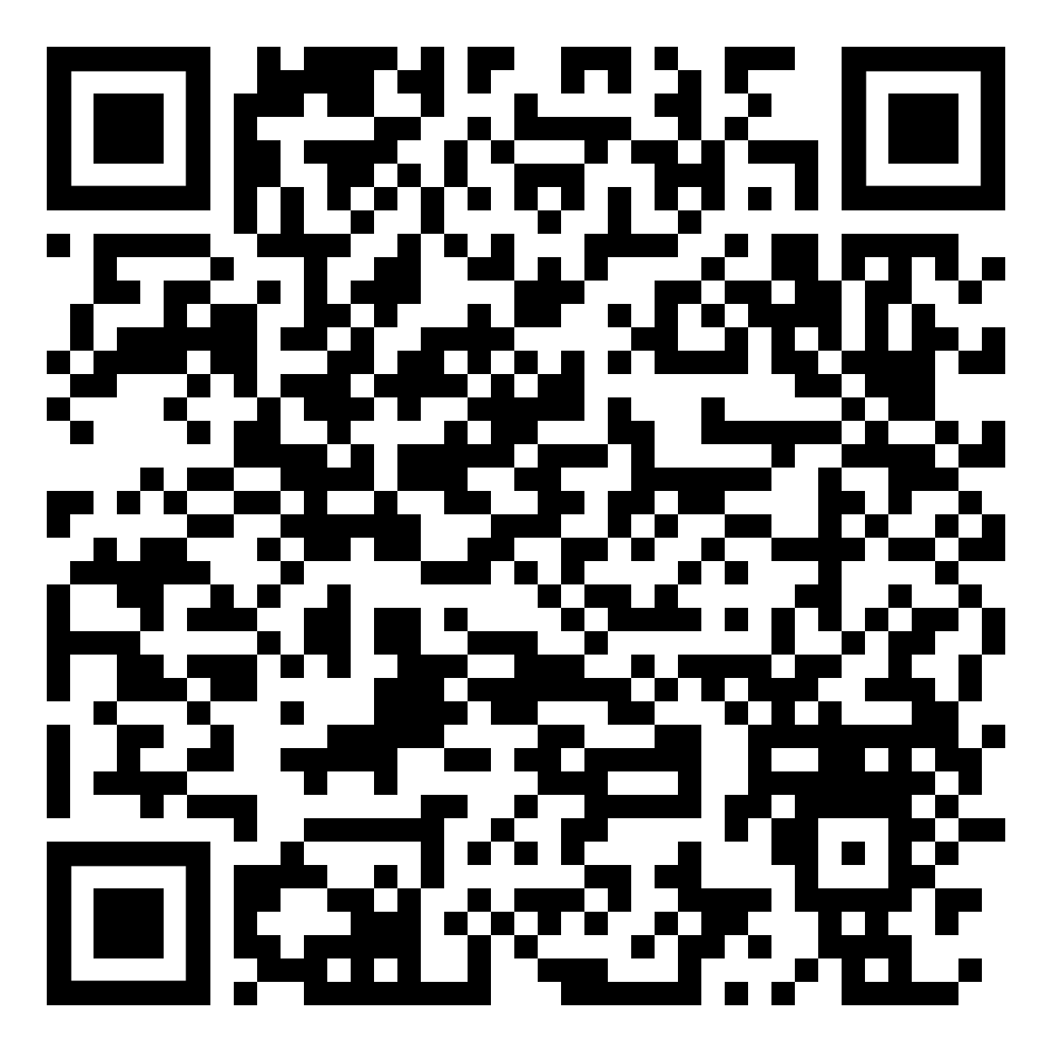
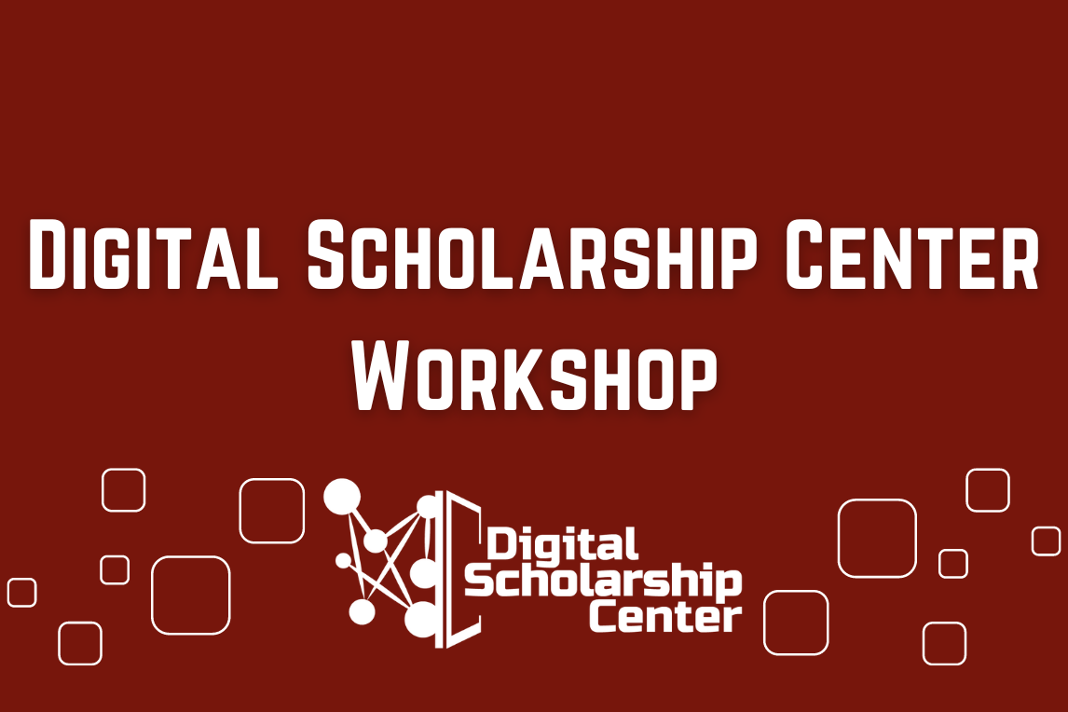
Upcoming Events in the DSC

